Slide 1
Syllabi
Search
Process
Step-by-Step Instructions to Find Syllabi in the Class Schedule Online

Slide 2

Step 1
Go to the A-State Home – Page at www.astate.edu

Slide 3
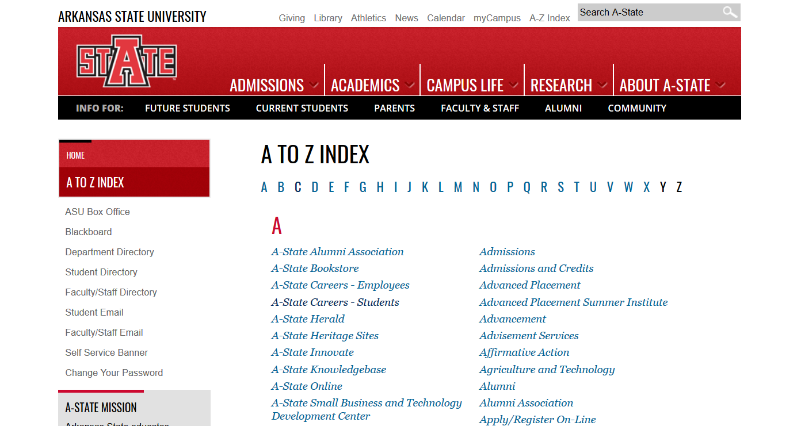
Step 2
Click the A-Z Index on the upper right hand side of the screen (http://www.astate.edu/info/az/) and click on the C in the alphabet list at the top.

Slide 4
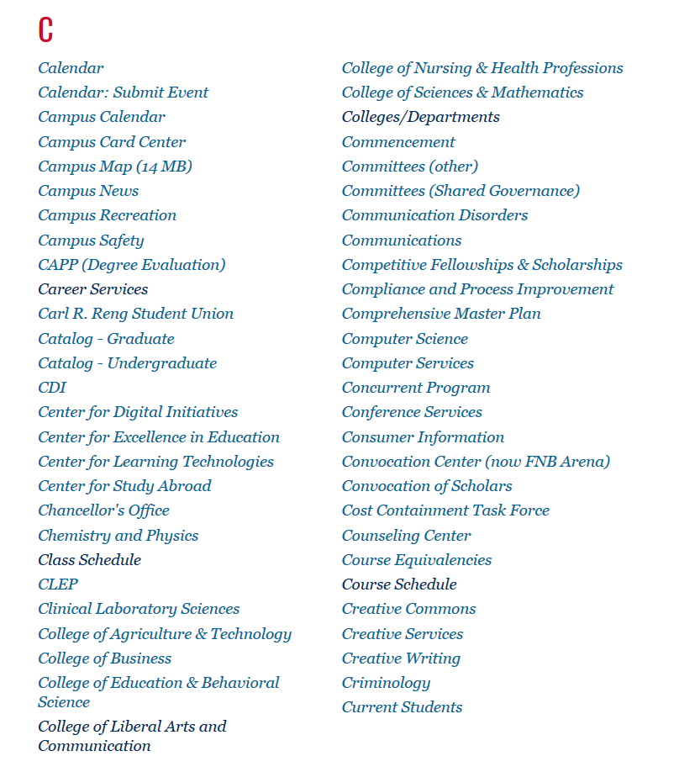
Step 3
This will take you to the “C” section of the A-Z index where you will find Class Schedule listed. Click on that link.

Slide 5
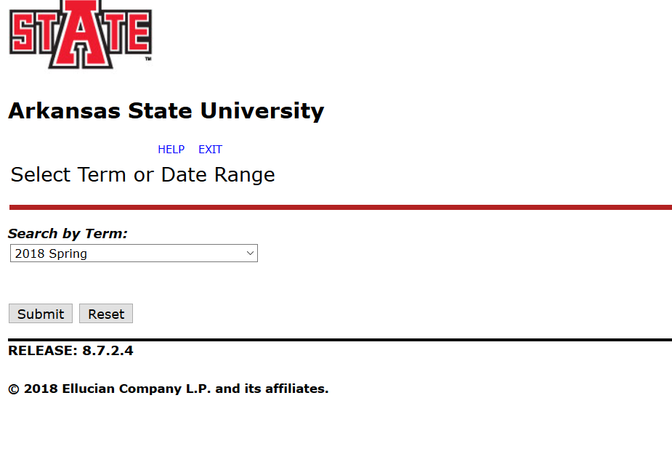
Step 4
Choose the term in which you would like to search. Even the “view only” terms will hold syllabi links. Hit Submit.

Slide 6
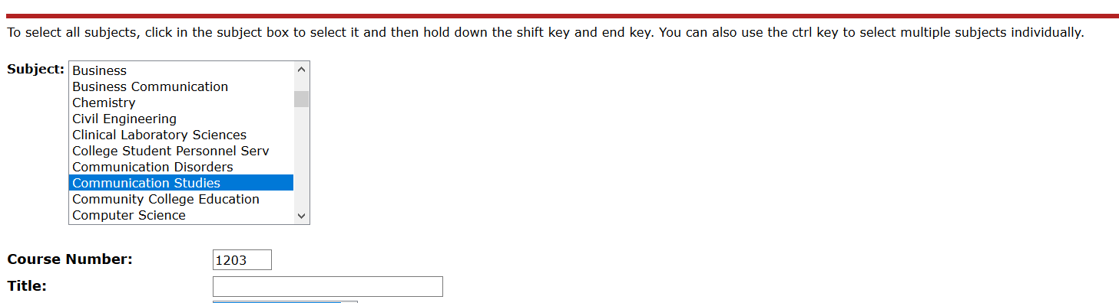
Step 5
Follow the instructions on this screen to search for the course you wish to view. See a few hints below if you cannot find the course you are searching for. When you are done, hit the Class Search button.
Searching with as few variables as possible works best. For example if you want the Monday section of Oral Communications at 10:00 am, only search for Communication Studies (COMS), which is the subject, and course number (4 digits).
You may also search for multiple Subjects by using the CTRL function to select multiple Subjects, or the SHIFT function to select a section of Subjects. For example if you want all of the courses in the first half of a semester, you may SHIFT select all of the Subjects, and click 1st Half Term or 1st Summer to look at all of the courses offered in the part of term. This may take a while to pull.

Slide 7
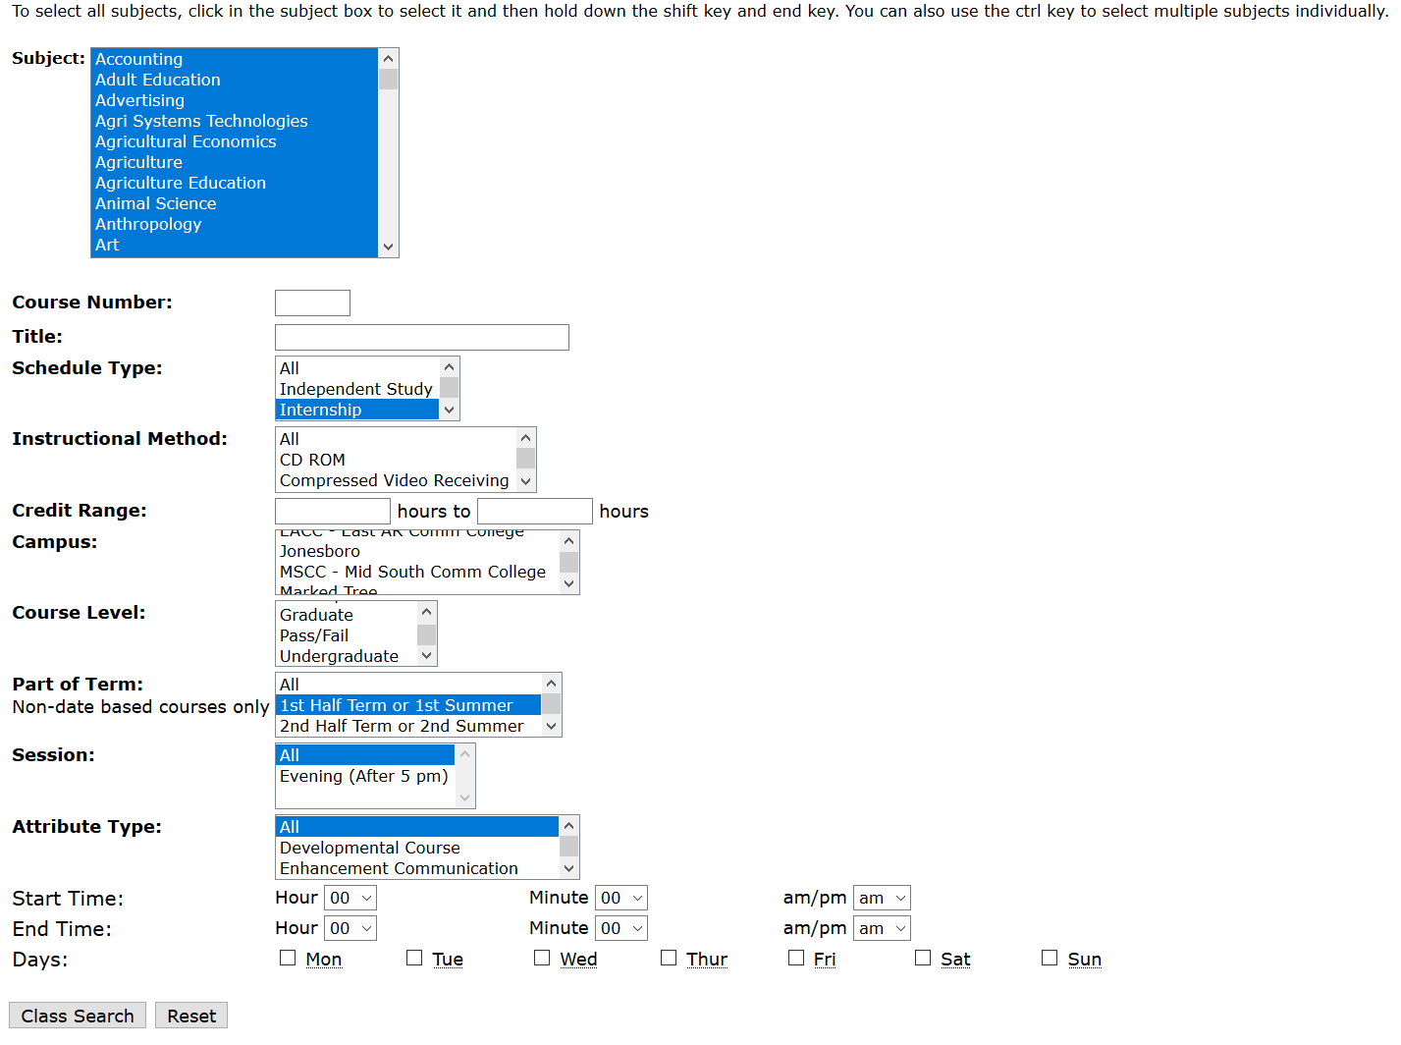
Step 6
Click the Class Search button at the bottom of the page to execute the search.

Slide 8
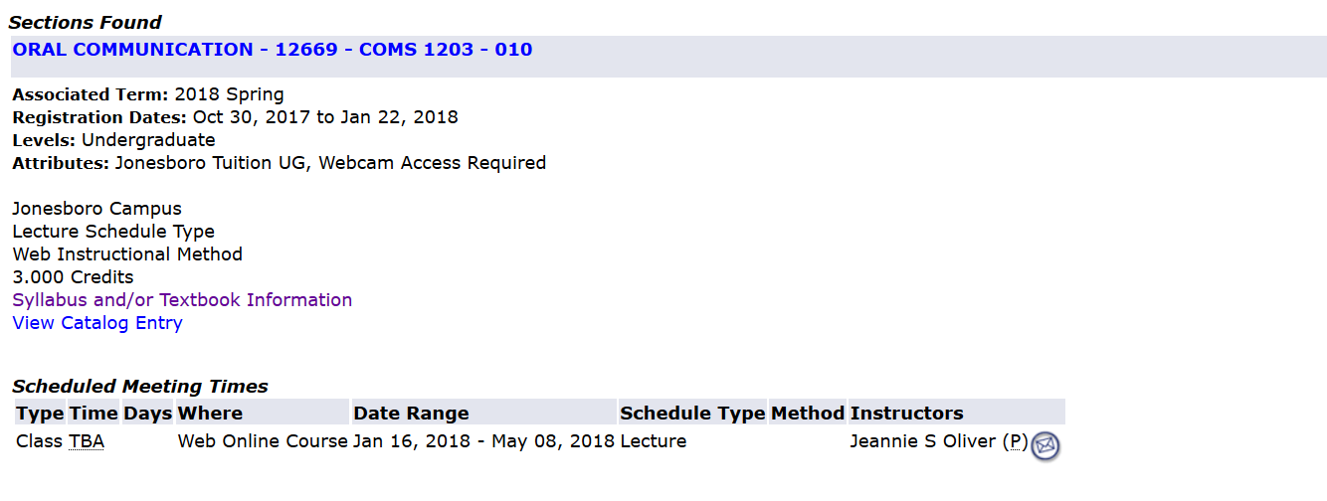
Step 7
The Class Schedule Listing page will list all courses that match the search criteria for the term you are in. Scroll until you find the course you are searching for, and then click the Syllabi's and/or Textbook Information link for that course.

Slide 9
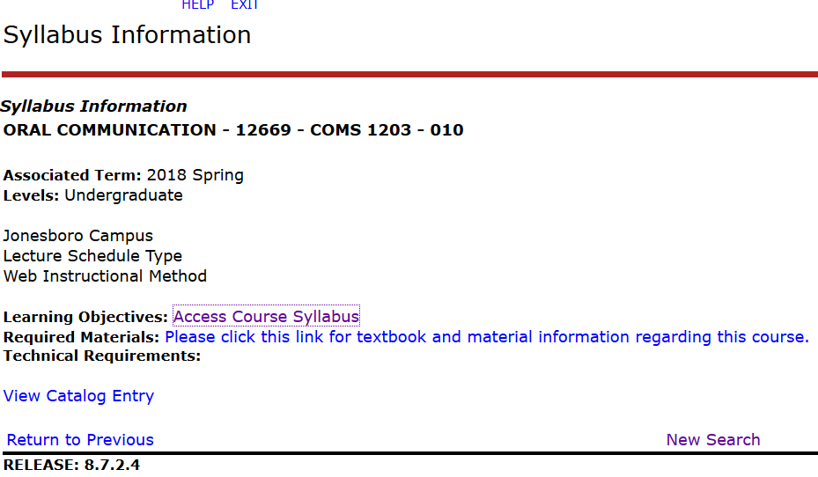
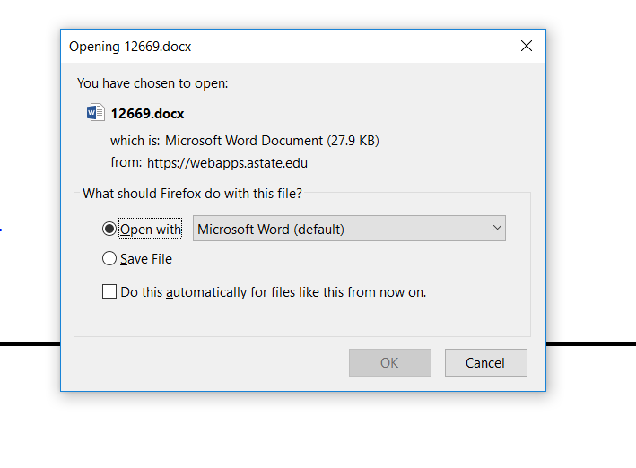
Step 8
The last step is to click on the Access Course Syllabus link list on the syllabus information page. This should open a dialog box for the Word document you are trying to open. Clicking “open with” should open the document in Microsoft word for your viewing.

